Slide 1
Data-Driven Fish Model
Arthur Mateos and Christopher Zhang
26 July, 2017
Notes:
Hi

Slide 2
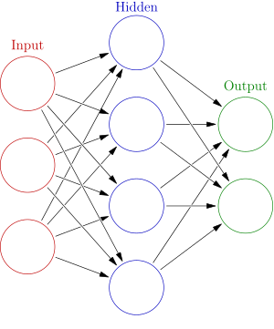
Our Problem
We want to use neural nets to learn and predict social interaction of fish
https://en.wikipedia.org/wiki/Artificial_neural_network
Notes:
Goal: model fish behavior
Want data-driven model to study collective motion of fish swarms, since models currently being used are 10 years old
Previous approaches have looked at sets of preselected features or are limited to pairwise interactions; using data-driven approach lets us eliminate human biases in designng model

Slide 3
Outline
Introduction
What we did
Challenges and future directions

Slide 4
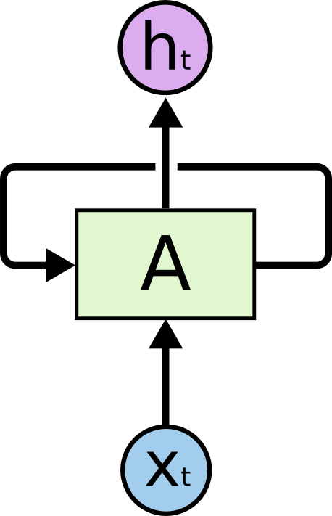
Processing Sequences
Recurrent neural nets (RNN) — neural networks with memory
http://colah.github.io/posts/2015-08-Understanding-LSTMs/
Notes:
Classical neural nets do not have memory, but RNN can. Thus, we can input sequnces of data. We will input sequences of fish trajectories. The model might not be able to predict future trajectories based on the past, but it can learn how fish trajectories look like.

Slide 5
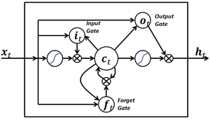
Long Short-Term Memory (LSTM) Cell
Used successfully for:
Handwriting generation (Graves 2013)
Text generation (Graves 2013)
Speech recognition and natural language processing
https://en.wikipedia.org/wiki/Long_short-term_memory
Notes:
The very popular recurrent neural network architecture. Very successful in many tasks.
LSTMs overcome past difficulties w/ RNNs

Slide 6
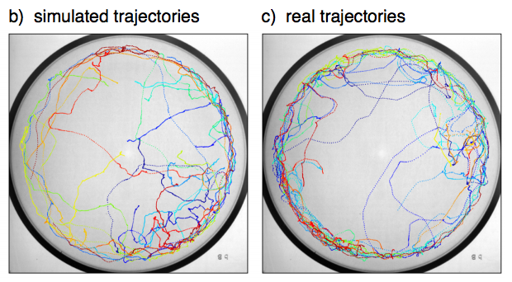
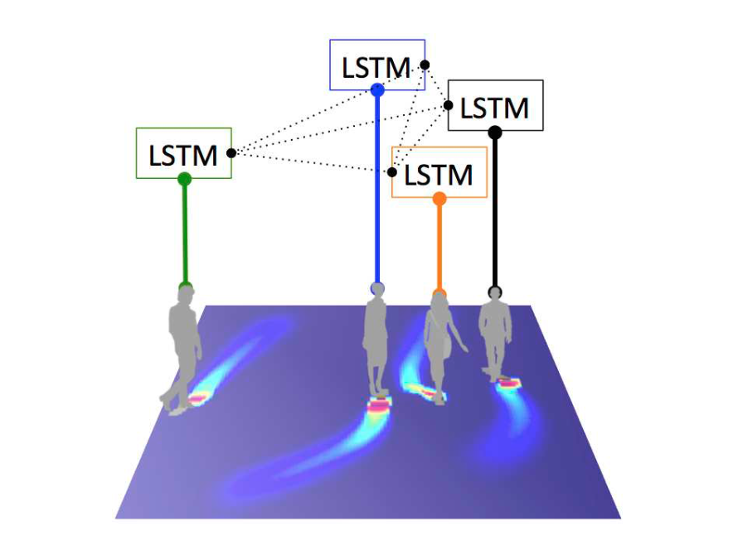
Related work
Alahi et. al., 2016
Predict human walking trajectories
Trained on real human data to model social interaction patterns—e.g., avoidance
Eyjolfsdottir et. al., 2017
Generate fly motion trajectories
Used LSTM architecture
Eyjolfsdottir et. al., 2017
Alahi et. al., 2016 Social LSTM

Slide 7
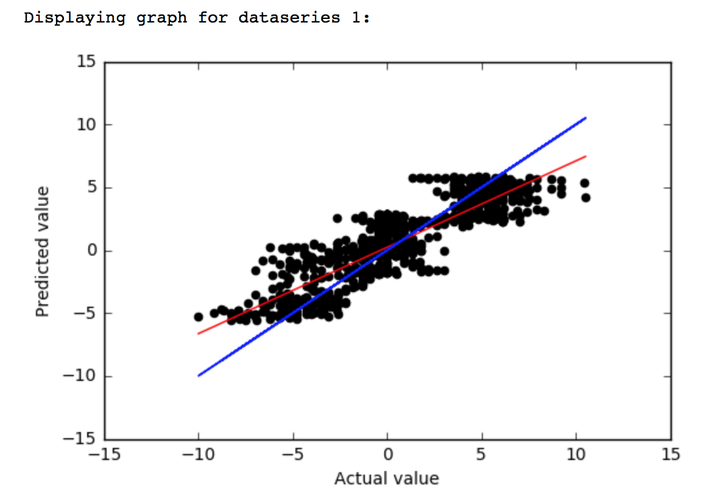
Our model
Data: stickleback motion videos, preprocessed to extract position
Input: x, y fish coordinates of last 50 frames and distance to boundaries
Output: change in x, y for next frame
Feed output back into prediction network to generate simulated trajectories
Model predictions vs. ground truth

Slide 8
Results: single fish
Model learns:
Location of boundaries
Tendency of fish to stay near boundaries
Pattern to swim in bursts and coast
Notes:
Observe: learns boundaries, stays near boundaries, swims in bursts
Initially: violated boundaries—then following Social LSTM, added RELU embedding of inputs; this fixed it

Slide 9
Results: multiple fish
Work in progress… BUT:
Fish move collectively
Avoidance of other fish (mostly)
Notes:
Work in progress…
Observe: moving collectively, avoidance (mostly), not too far from boundaries?

Slide 10
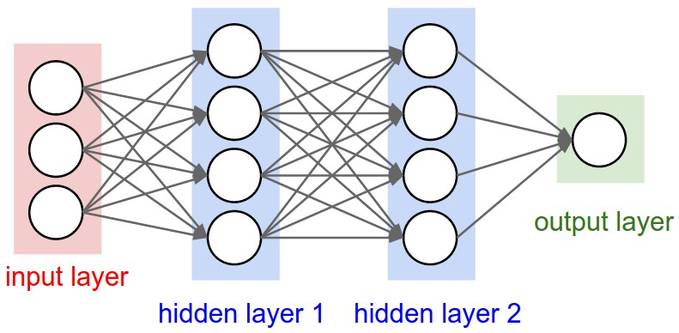
Challenges/obstacles
Challenges with simulating fish
Wall detection
Deterministic motion
Fish motion may not be predictable
Trying to predict too far in the future
Challenges with computers
Model learns periodic motion
Getting the GPU to work
Neural networks train very slowly
Having a big enough network
Embed
ReLU
http://cs231n.github.io/assets/nn1/neural_net2.jpeg

Slide 11

Future directions
Train with more data
Adjust network structure, tune hyperparameters
More neurons per layer; more layers?
Use Social LSTM model—agent-centric approach
Different input formats—e.g., ray-casting/visual information
Different output formats—e.g., change in speed, turning angle
Add randomness
Draw turning changes from gaussian
Predict probability density, draw from it
Quantitative analysis of model quality
https://www.nature.com/nature/images/journal_header_v3.jpg
Notes:
Have discussion with audience

Slide 12
Acknowledgments
Jacob Davidson
Ben Koger
Jolle Jolles
Iain Couzin
Jake Graving and Vivek Hari Sridhar
Couzin Lab and Jordan Lab
Max-Planck-Institut Für Ornithologie and Univeristät Konstanz
Princeton IIP

